Slide 1
How to leverage 2D display in the Azure Portal to achieve more

Slide 2

Problem Statement(s):
Azure Resources
Creation
Customer onboarding takes several month due to complexity of Azure
Templates are hard to explore, sort through and understand
There is no visual correlation between reference architecture diagram used and the actual implementation
Monitor
Customer complaint that they are not able to see the big picture easily
Regression from on-prem where customer were using visio diagram with monitoring layout
Improve
Customer are lost by the diversity of tools available to help them (ASC / Advisor / Policy / … )

Slide 3
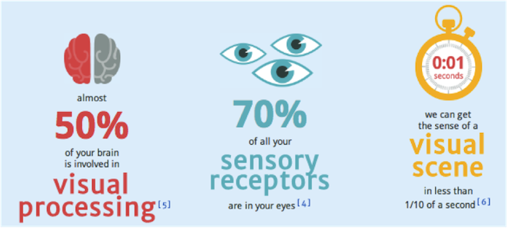
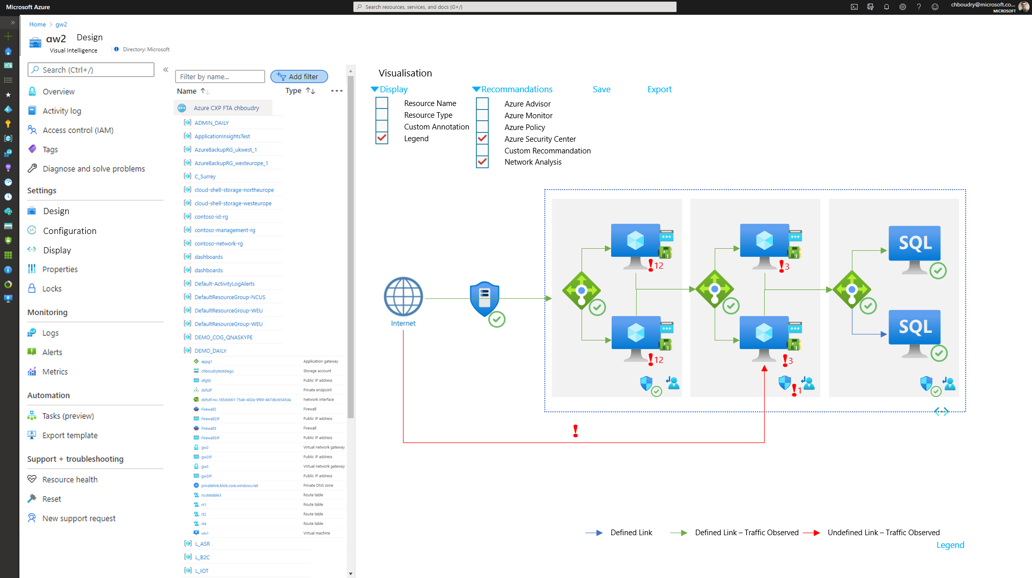
Solution Hypothesis:
A picture is worth a thousand words.
Goal:
Creation
Make it easy to see what is being built
Creation view and monitoring view is the same single experience
Monitor
Overlay on top of diagram
Improve
Overlay on top of diagram (ASC / policy / advisor)
Extensible to other topics (cost, partner integration)

Slide 4
The challenges
ARM is not built for visual design and does not onboard all the needed information
How to design a service that can retain those information on top of ARM
Azure Resources and in between relationship are quickly evolving over time
How keep the 2D design up to date

